Slide 1
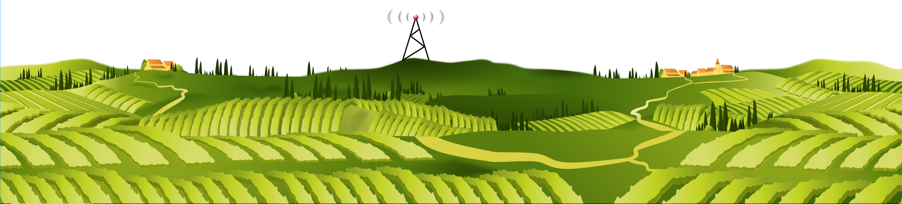
THE ULTRASWITCH - a remoteqth project by DM5XX -

Slide 2
remoteQTH.com
OPEN-SOURCE Hardware + OPEN-SOURCE Firmware
OK1HRA, Dan | OK2ZAW, Jan | OK1CDJ, Ondra | DM5XX, Mike
https://remoteqth.com + qro.cz + hamshop.cz = OL7M
K9AY
Beverages: Top band, single band, bi-directional 2-wire, 4-way bi-directional,…
Switching: 6To2/6To1/4To1, 6To2+Triplexer, 1To2/1To3 Stackmatch, 12x4,…
Variable ATT, SO2R, M/M, Controller (on-site/remote), Custom Contest Hardware…

Slide 3

DM5XX
Radio amateur since 1990 (OK8XX, DM5X, ex. DG3NED, ex. DL3NED) living in Nuremberg
Senior Software Engineer
IT-Project Lead @ ADITUS GmbH
Since 2015 Lead Firmware Developer @remoteqth.com
Main responsibility for embedded microcontroller firmware

Slide 4
The Ultraswitch
Wifi based & inspired by mega-webswitch (63-CH remote-switch)
Part of the 256-Port-Inband-Antennenproject @ OL7M
Simple hardware direct from China (ebay.com)
ESP8266-12F („Wemos D1 mini“)
Modular: Up to 8 Boards
Web-UI & Web-Config
RESTful and simple extendable thanks to ist web based architecture
Pre-Programmed kits available from dm5xx@gmx.de

Slide 5
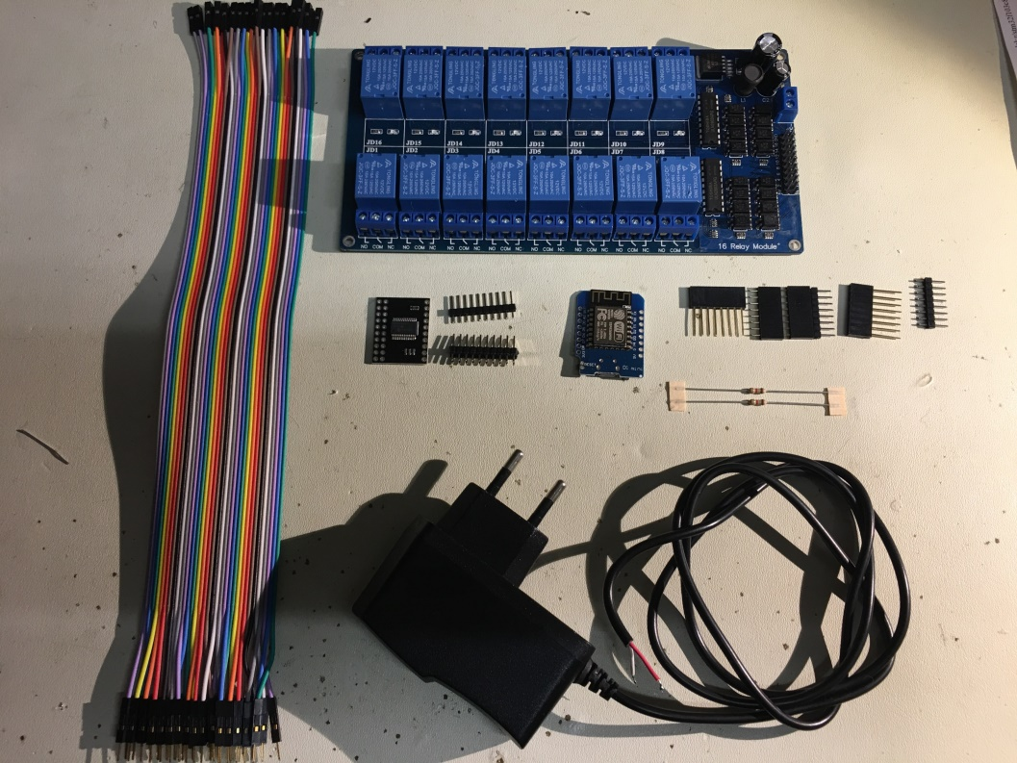
Needed Hardware
16-CH 12V-Relayboard
MCP23017SMD on a PCB (I2C=>16 Port)
Wemos D1 mini (ESP8266-12F, Controller)
2x 1.8K/2.2K
DuPont connector
12V-Power supply
Computer+MicroUsb-Cable

Slide 6


The architecture
Separation of Concerns:
Hardware layer (1)
Hardware based functionality (JSON) (1)
Function layer (JS) (2)
Presentation layer (UI) (3)
=> aka 3-Layer-Model
Browser: (3) UI
Javascript: (2) Control
(1) ESP12F/RelayBoard

Slide 7
Pros and Cons
Pro:
Simple extendable, not dependend on the UI (Web-App, Windows-App, Mobile-App, Linux-App,…)
Seperation of hardware, logic and (business) functions
Centralized, modular, web technology, ready for future demands
Add your own functions and/or UI (Customizing)
Cons:
Security concerns are up to you (use a VPN if using remote access)
The more you are customizing, the more you need to know (learning curve)

Slide 8

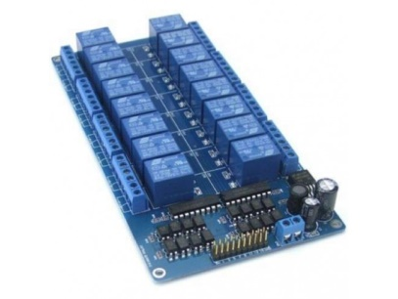
Usecase 1 – „Out of the box“
No changes to be made
All already available resources („h.mmmedia-online.de“) are used.
Just the configuration of the switch is necessary (IP-Adress)
Software is always up-to-Date
Cons: You cannot change something – including the labels.
HTTP-Response
Own Browser
Ultraswitch:
Index.html
HTTP-Request
h.mmmedia-online.de
Javascript:
ultraswitch_v1.js,
ultraswitch_content_v1.js
CSS:
Ultraswitch_v1.css

Slide 9
Usecase 2 – Using ur own „Desktop-Application“
Easy to custimize
All resources are local on ur PC
Everything is customizable
No own webserver is needed
Cons: No updates out of the box, no longer multi-user capable (Logic/Infos are on ur own pc). Not mobile accessable.
HTTP-Response
PC:
Index.html
Own Browser
Javascript:
ultraswitch_v1.js,
ultraswitch_content_v1.js
CSS:
Ultraswitch_v1.css
HTTP-Request

Slide 10
Usecase 3 – „Own Webserver“
All advantages of Case 1 and 2
Multi user capability
Server could be in your own network
Cons:
Webspace needed
Knowledge in web techniques needed
Updates no longer out of the box
HTTP-Antwort
Eigener Browser
Ultraswitch:
Index.html
HTTP-Schaltbefehl
www.ownservername.de 192.168.1.1
Javascript:
ultraswitch_v1.js,
ultraswitch_content_v1.js
CSS:
Ultraswitch_v1.css

Slide 11

Good to know
Computer networks
Network protocols
JSON
HTML, CSS, Javascript
Introduction into REST

Slide 12
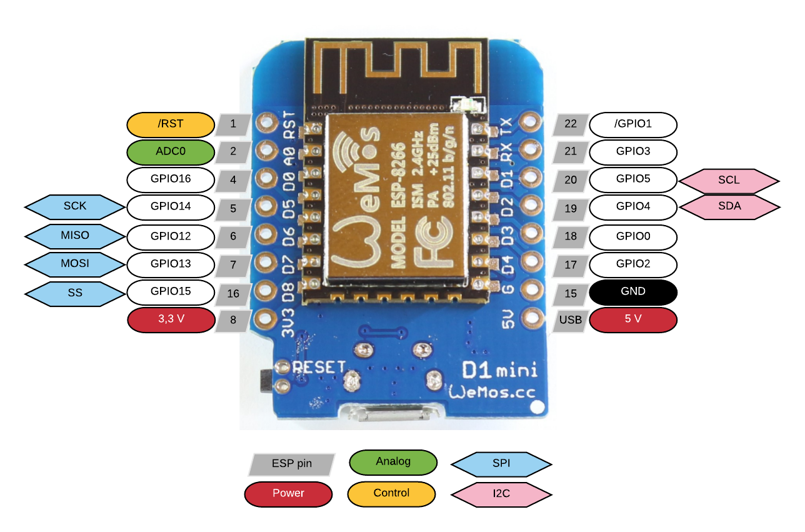
Hardwareplattform – ESP8266-12F
802.11 b/g/n, Wi-Fi 2.4 GHz, support WPA/WPA2
Integrated low power 32-bit MCU @80mhz,4MB Ram, 92kb
Integrated 10bit ADC
Integrated TCP/IP protocol stack
Integrated TR switch, balun, LNA,
power amplifier and matching network
Integrated PLL, regulators, and power management units
Supports antenna diversity
Support STA/AP/STA+AP operation modes
Support Smart Link Function for both Android and iOS devices
SDIO 2.0, (H) SPI, UART, I2C, I2S, IRDA, PWM, GPIO, STBC, 1x1 MIMO, 2x1 MIMO
Deep sleep power <10uA, Power down leakage current < 5uA
Standby power consumption of < 1.0mW
Datasheet

Slide 13
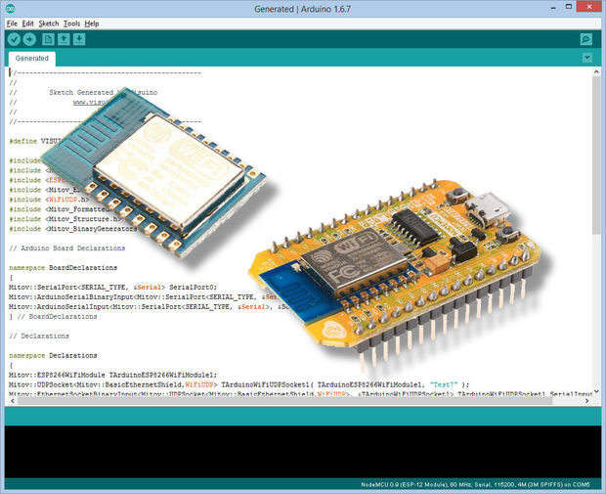
Arduino-IDE
Installing Arduino IDE
https://learn.sparkfun.com/tutorials/esp8266-thing-hookup-guide/installing-the-esp8266-arduino-addon
http://arduino.esp8266.com/versions/2.3.0/package_esp8266com_index.json (Use 2.3.0! 2.4.0 has a bug)

Slide 14
Libraries
Installing Additional Arduino Libraries (content of needed_libraries is copied to your local arduino library folder)
After IDE-Installation look for your project files…
C:\Users\mmmedia\Documents\Arduino => copy the folder „Ultraswitch“ into this folder
C:\Users\mmmedia\Documents\Arduino\libraries => Content of “Ultraswitch/needed_libraries“ are copied to this location
Copy to your desktop: (for later use) => Folder “ultraSwitch_web”

Slide 15
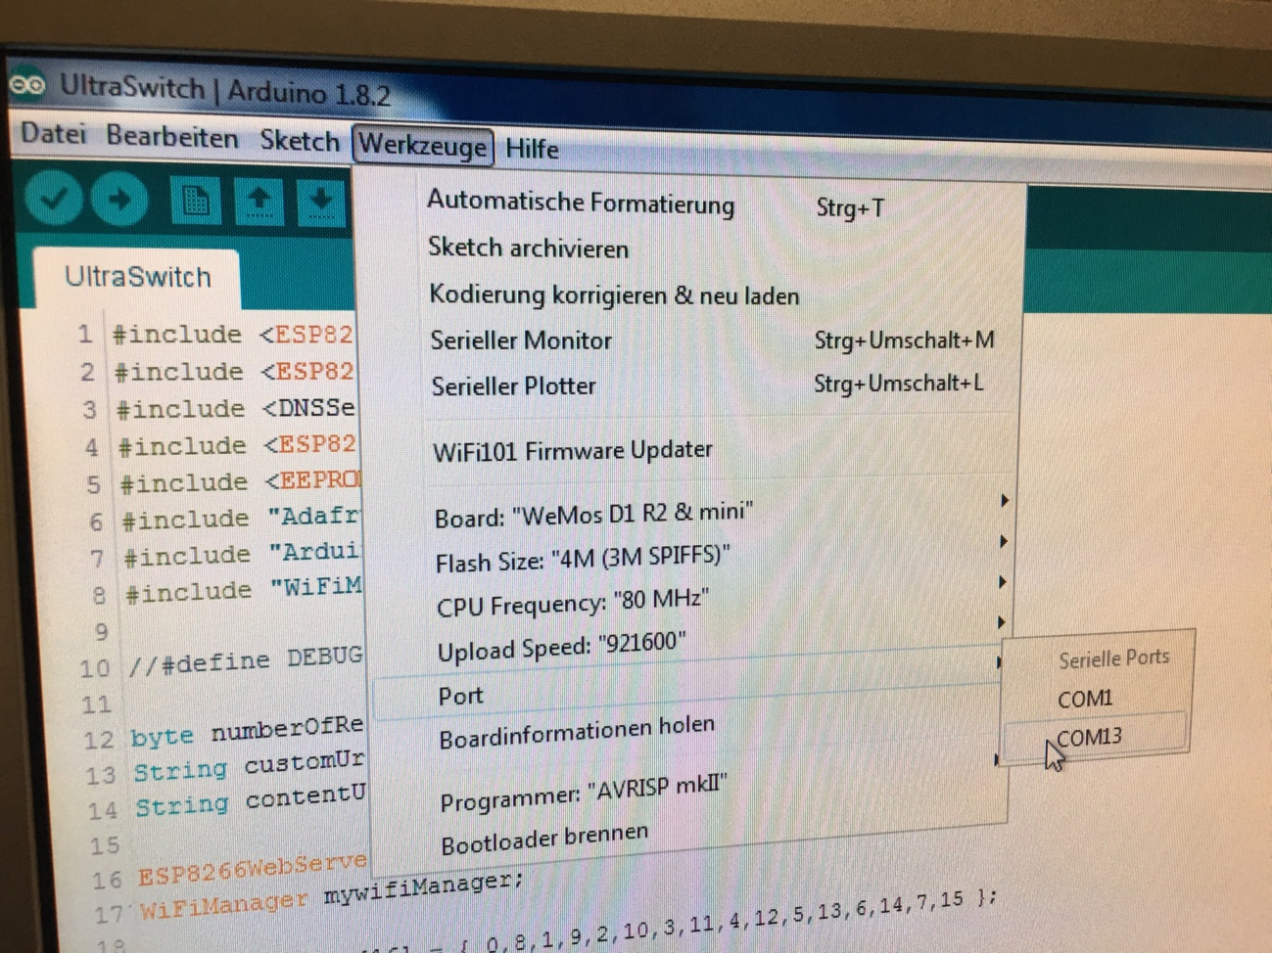
Lets go: 8266-12F
Board ESP added?
Libraries copied?
Sketch loaded? (ultraswitch.ino)
Preferences adjusted?
Serial port connected?
12F connected to usb?
Yes? => Verify > Upload!
engl.: „Tools“

Slide 16
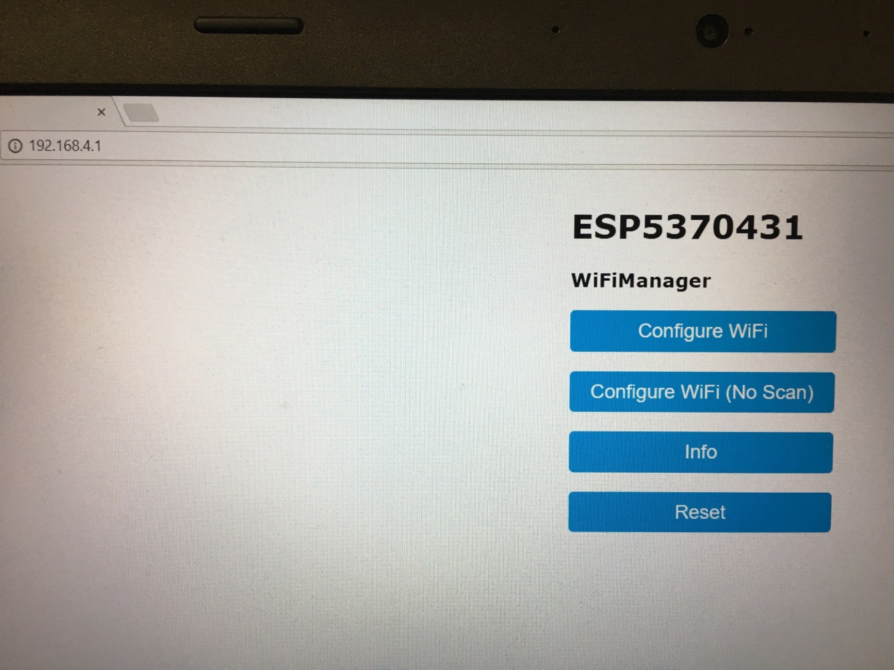
Connecting to the 12F – AP-Mode 1
Search for the Wifi-Network ESP<number> (with your smartphone)
Connect to this network ESP<number>
Open your Browser (Default: 192.168.4.1) – do nothing more yet!

Slide 17
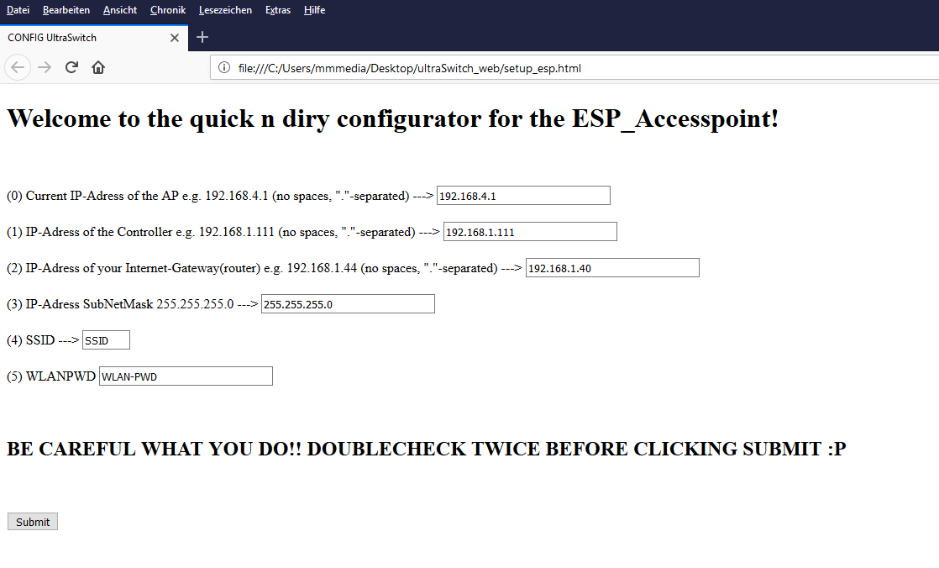
Connecting to the 12F – AP-Mode 2
Execute setup_esp.html in the folder „Ultraswitch_Web“ with a double click.
Change ur data – give everything its needed ip, mask, ssid, wifi-pwd
Submit!

Slide 18
Connecting to the 12F – AP-Mode 3
Connect your normal wifi
Open your 12F-Ip in your browser (z.B. 192.168.1.123)
„Configure Wifi“
192.168.1.123

Slide 19
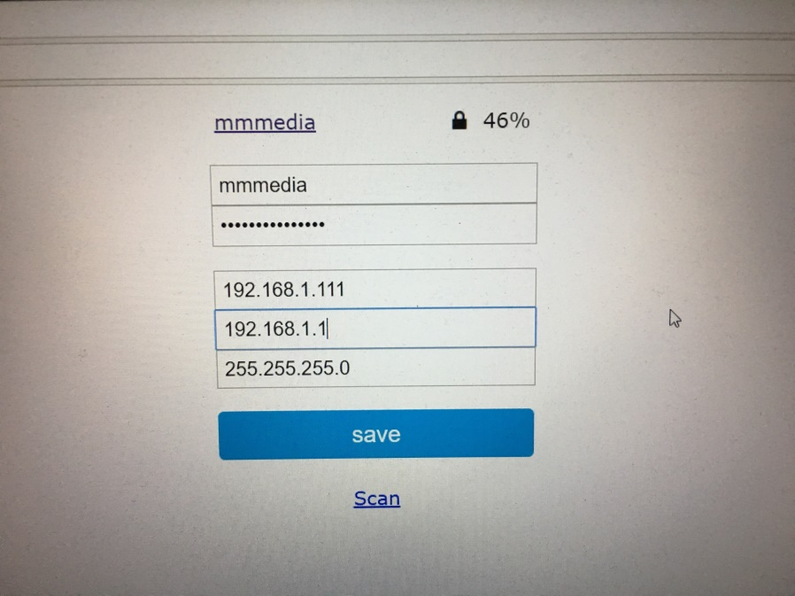
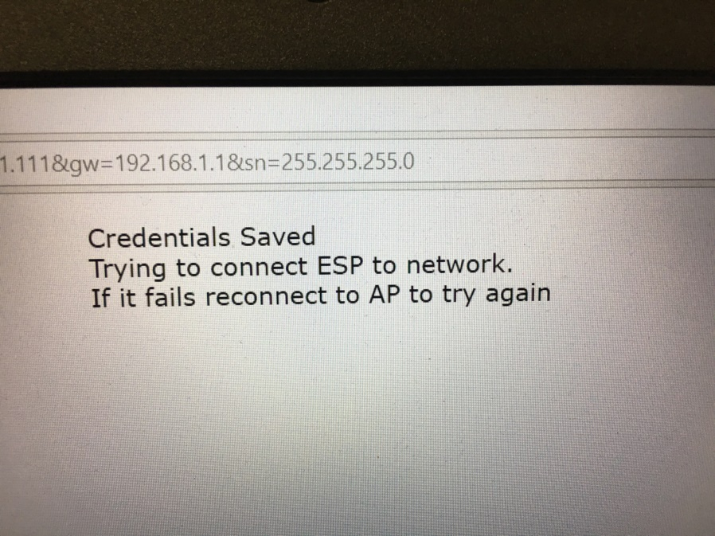
Connecting to the 12F – AP-Mode 4
„Configure Wifi“: Give SSID and Wifi-PWD again!
Double check your data! Save.

Slide 20
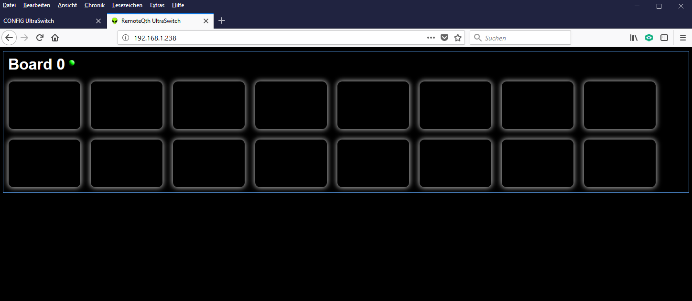
Connecting to the 12F – First contact
Call your Ultraswitch by its given IP.
Troubleshooting: Ultraswitch not found? Advanced IP-Scanner helps! Scan your network to find ist ip an try to set it again!
But you can see no buttons, …

Slide 21
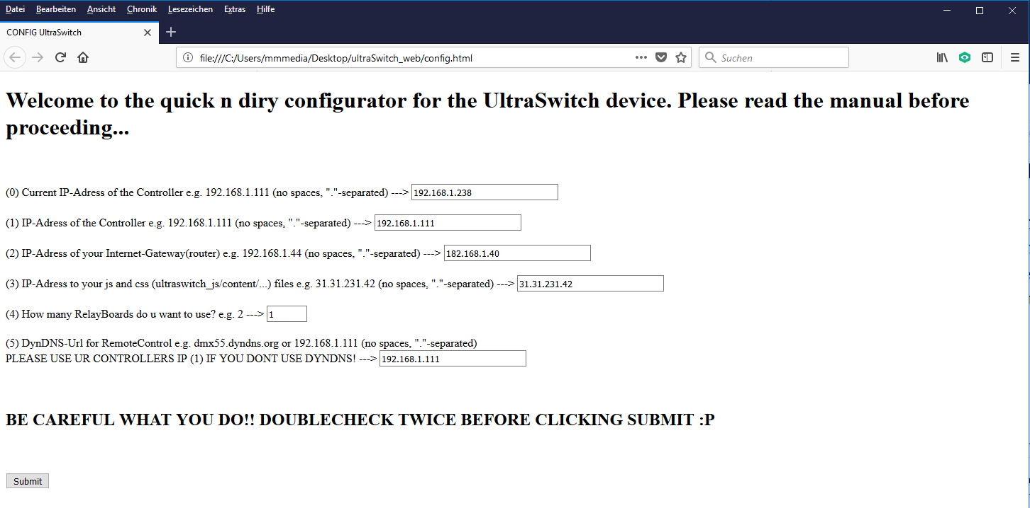
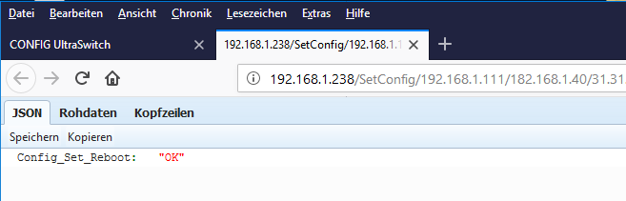
Connecting to the 12F – IP-Settings Servermode
Call Config.html
You need to know the IP of your Ultraswitch now!
You can give the ultraswitch another ip if u want
Add all needed info
Submit!

Slide 22
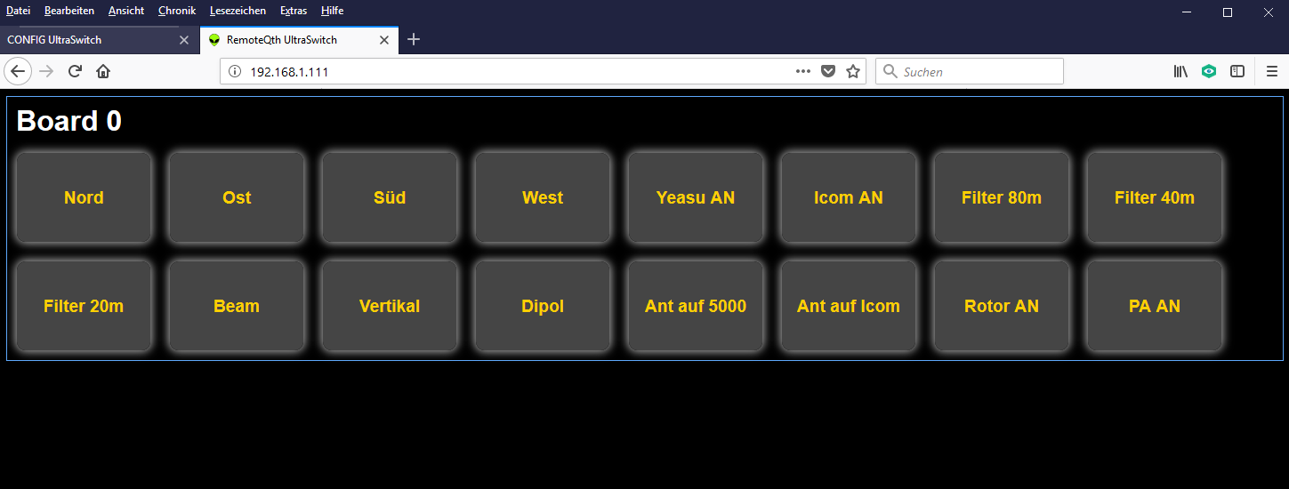
Final IP-Adresse of your Ultraswitch: The UI is working!

Slide 23
Something is wrong in your sketch... DEBUG!
Uncomment ultraswitch.ino: //#define DEBUG to #define DEBUG (remove „//“)
Upload your sketch
Tools => Serial monitor
Adjust Monitor Serial Speed from 9600 to 115200
Reset your Wemos (little switch on your Board)
Serieller Monitor shows your ip and switched pins...
Comment //#define DEBUG after you are done (upload again)

Slide 24
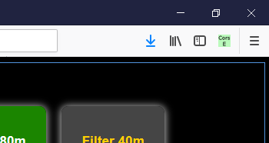
CORS – Cross Origin Request
Due to a Ajax-Request i could be, that your browser is blocking those cross origin requests, if you start the index.html from your desktop (file://file:///C:/Users/mmmedia/../../index.html)
Use: CORS Everywhere (Firefox) => Add to your Firefox => Activate CORS E („CorsE“ icon will be green)
Use Firefox!

Slide 25
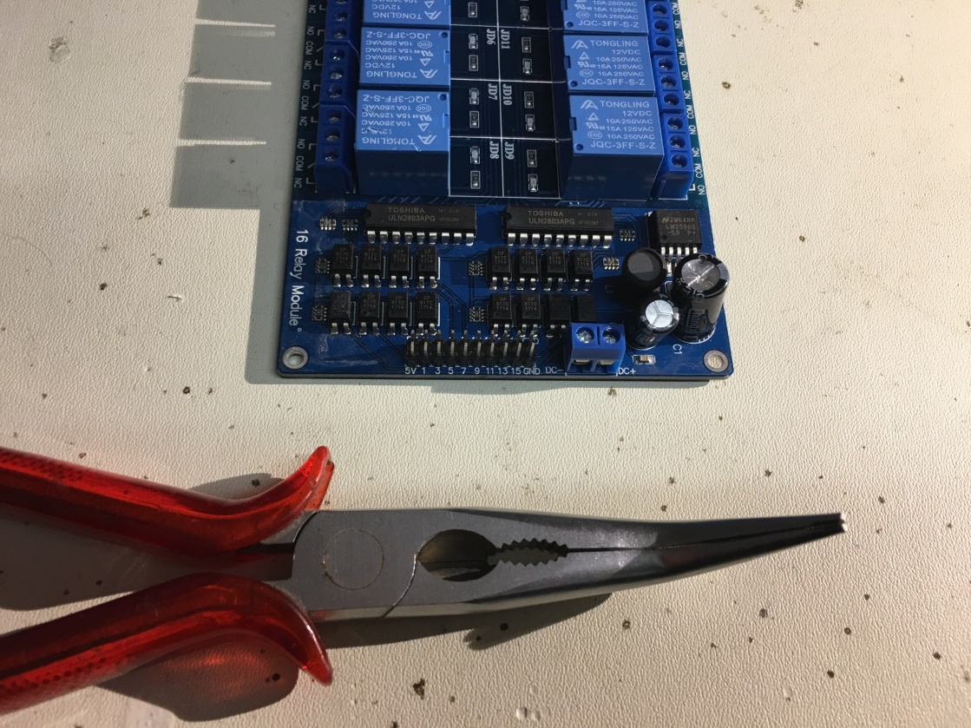
Wiring up your Relaysboard… 1
Use your pliers to bent your header pins of your relay board so they fit into the MCP-Board
Why? 2 Pins (3,4) from your MCP-Board need to be unconnected! Its not so easy..

Slide 26
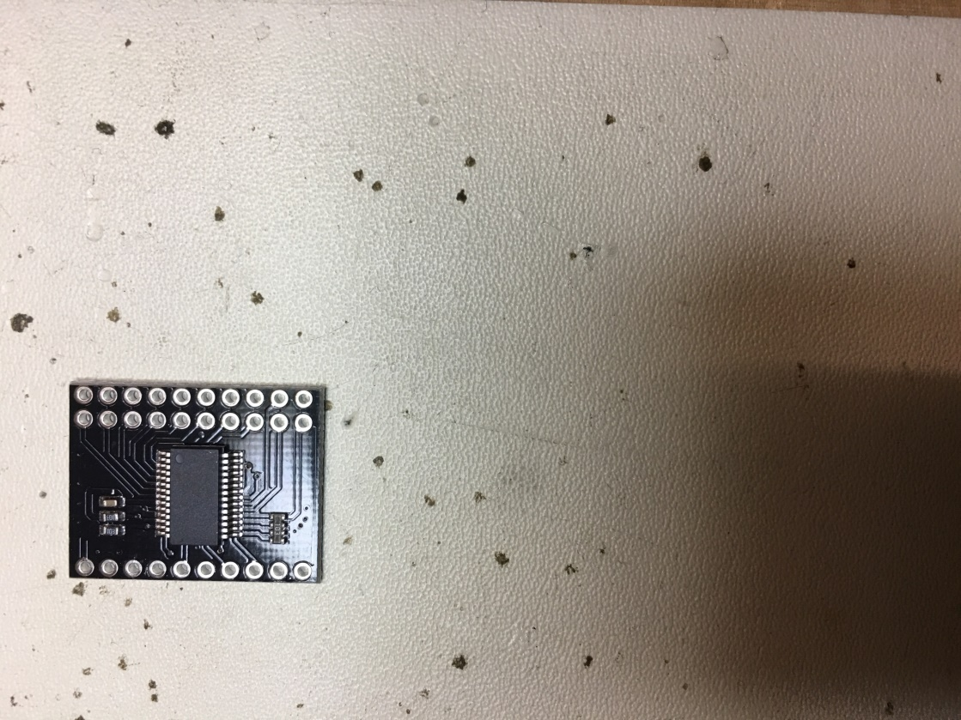
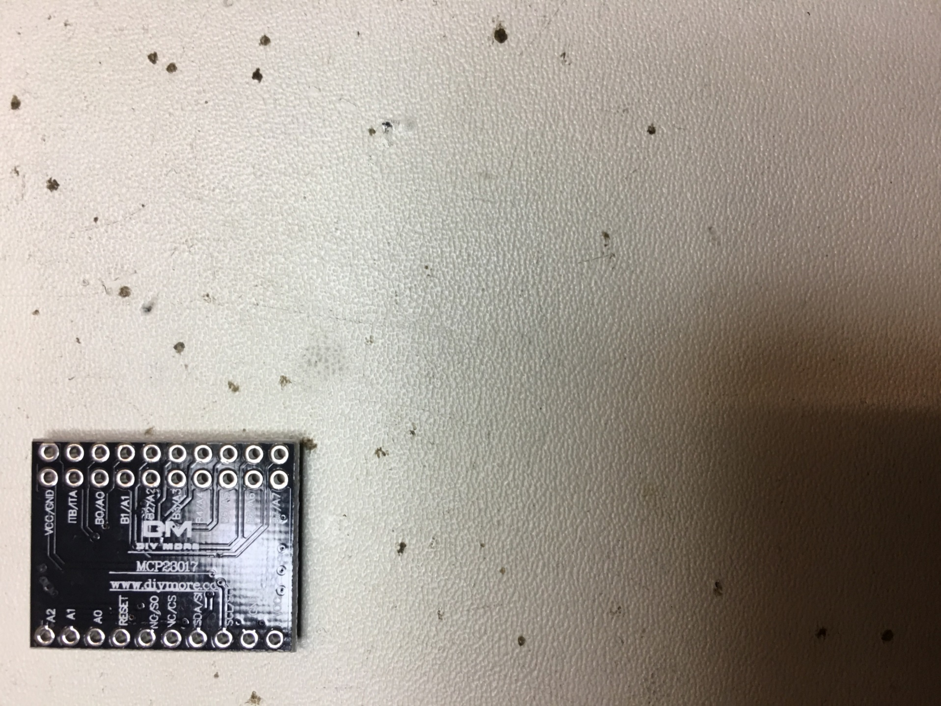
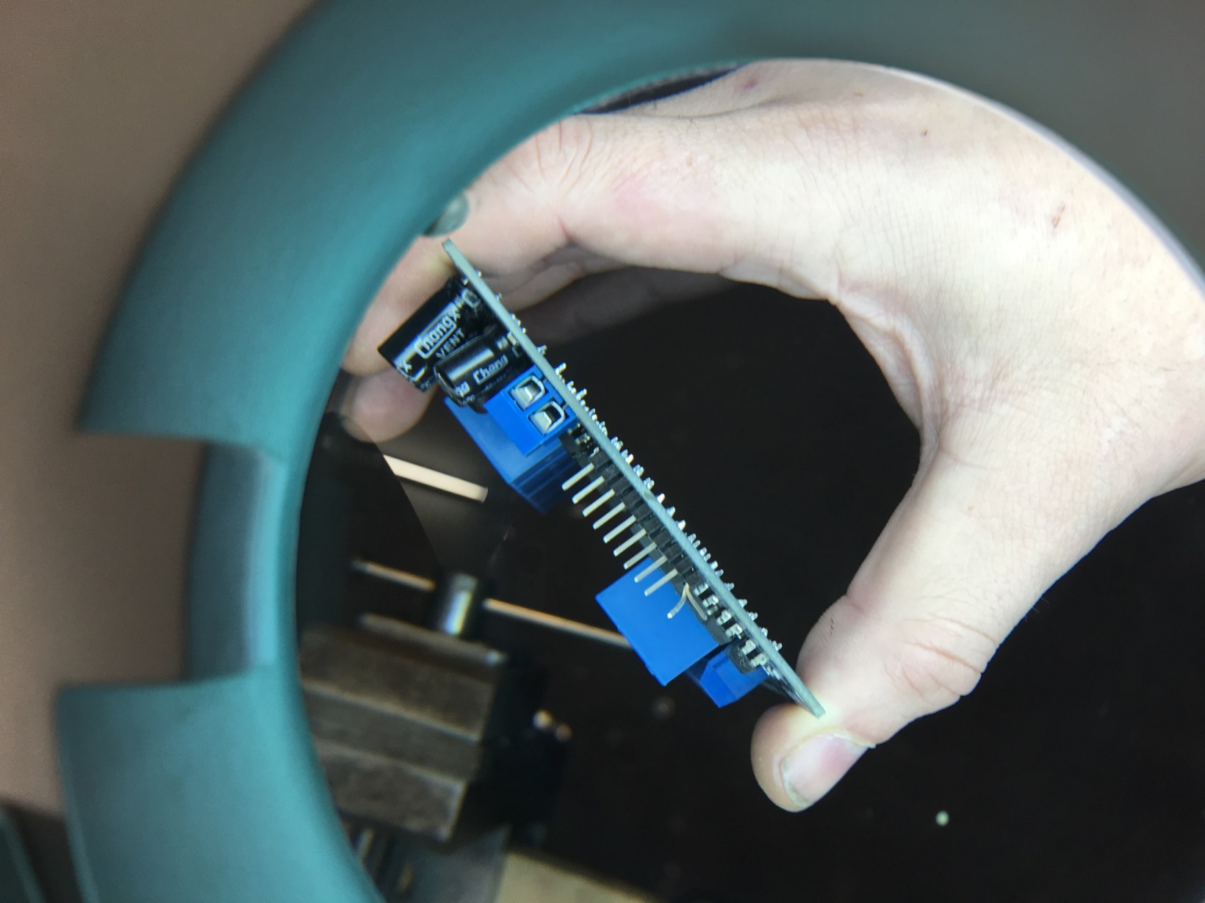
Wiring up your Relaysboard… 2
x
x
x
x

Slide 27
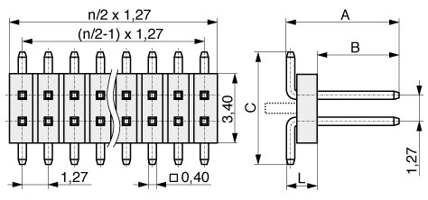
Wiring up your Relaysboard… 3
Pin 1: „Bent“ one grid to the left!
Pin 2: Bent completely down!
5V

Slide 28
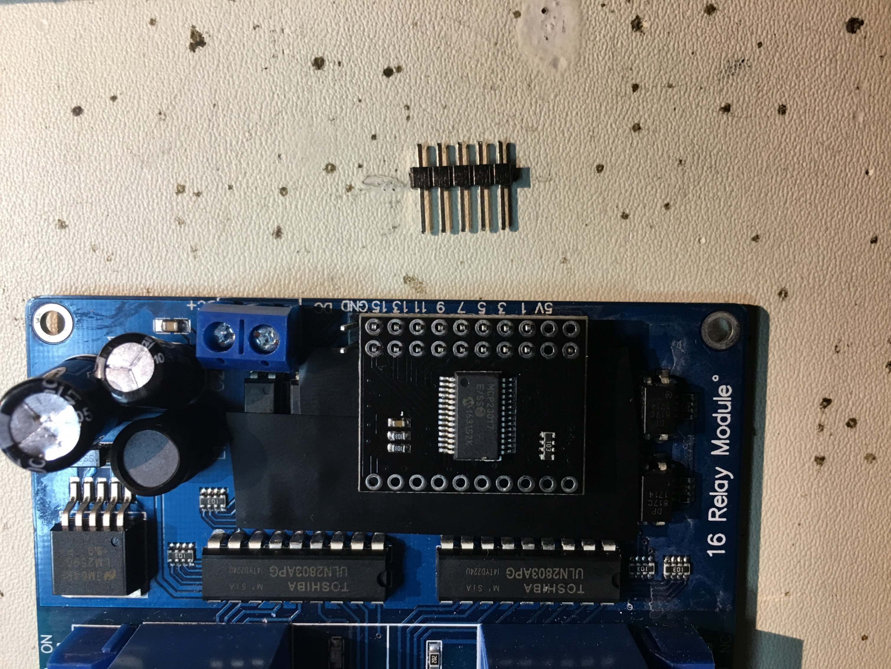
Wiring up your Relaysboard… 4
Connect the MCP-Board:
-1- the „S“ bent pin is visible. To be soldered later!
-2- complete bent pin is not visible
MCP Pin position ¾ is not connected.
On the right: Free GND-Pins (see: later))
Important: Do not solder anything yet! Just see if it fits already. Maybe re-bent.
1
2

Slide 29
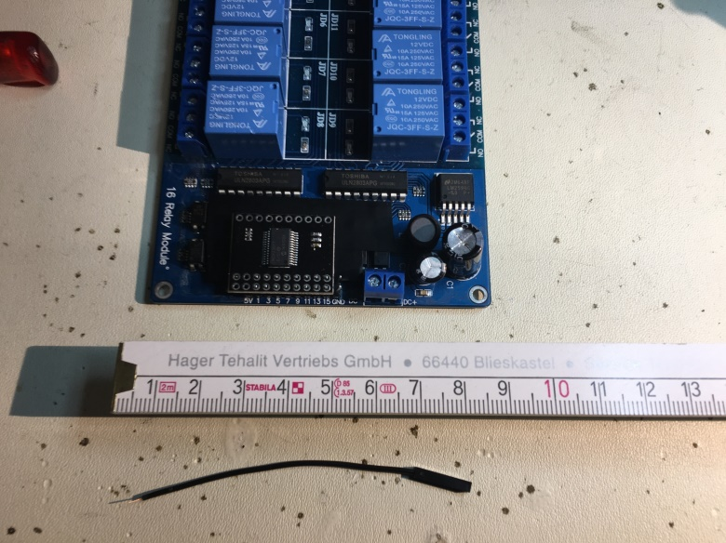
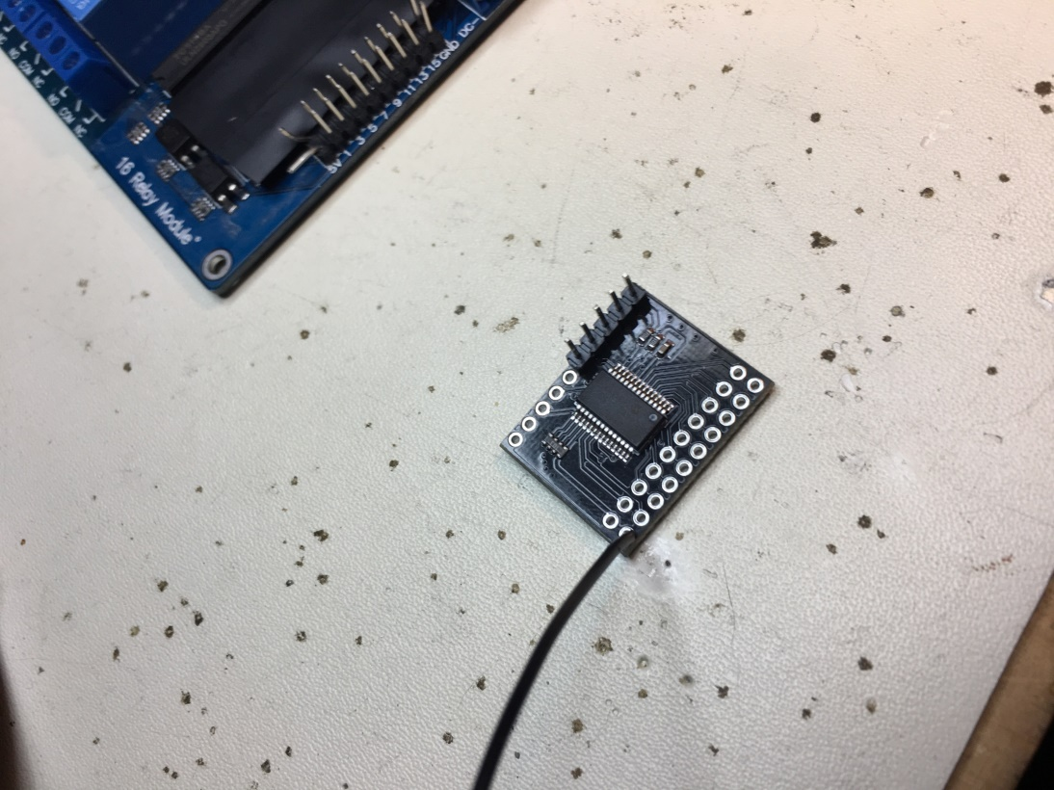
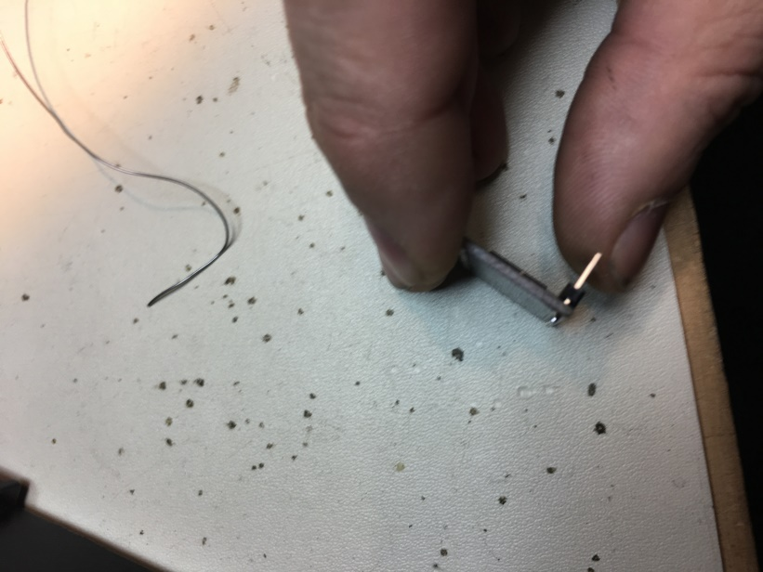
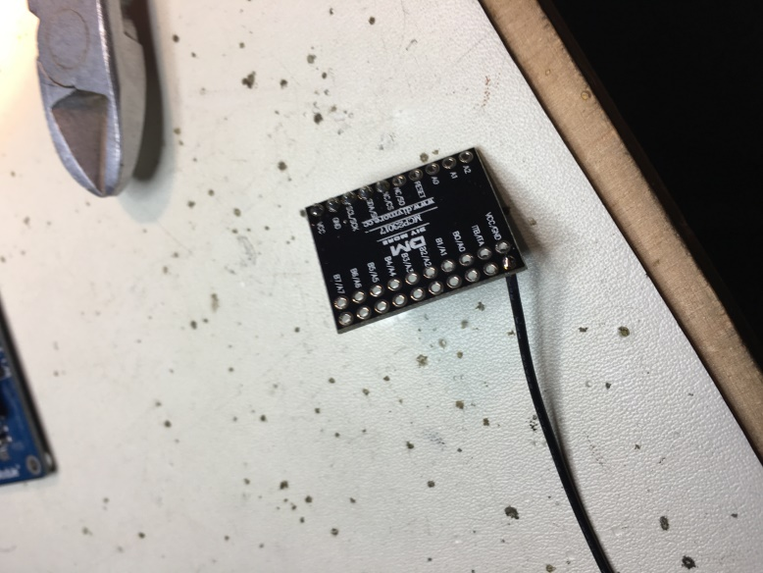
Connecting the MCP-23017 board
Use 4 Pin-Header and 1x GND-Wire and solder them:
x

Slide 30
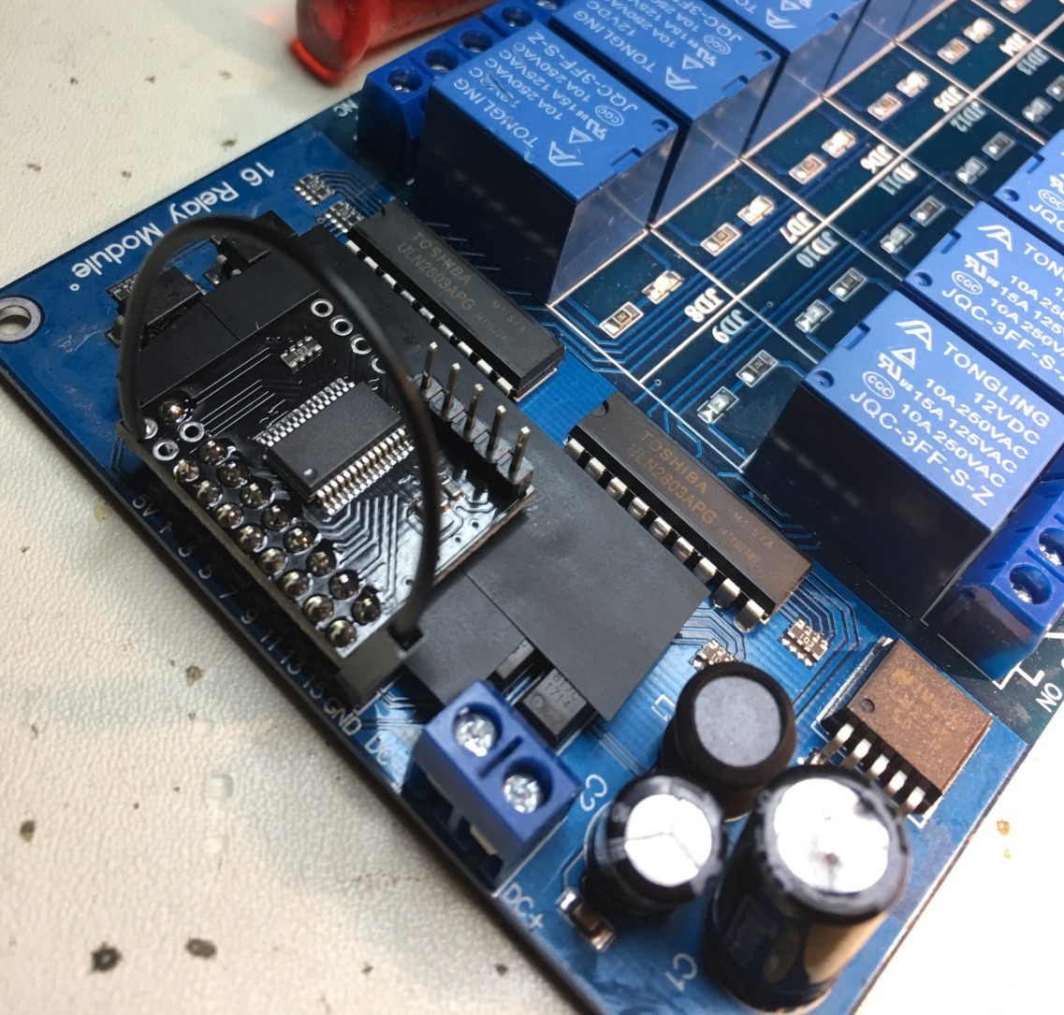
Soldering MCP-23017 board onto your RelayBoard
Use tape to reduce the risc of shortcuts
Place your MCP-Board correct
Solder all MCP-PCB connections to your Relayboard
Connect GND-Wire with your RelayBoard

Slide 31
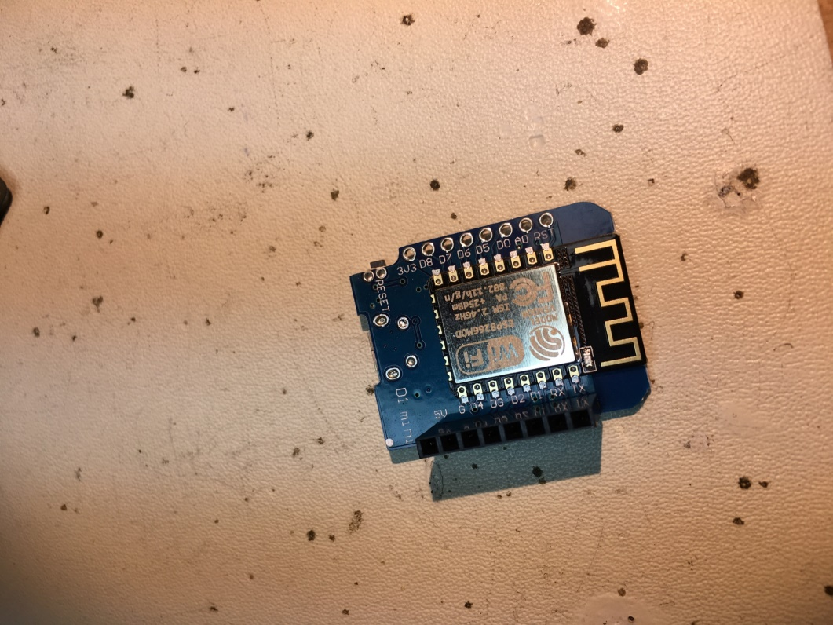
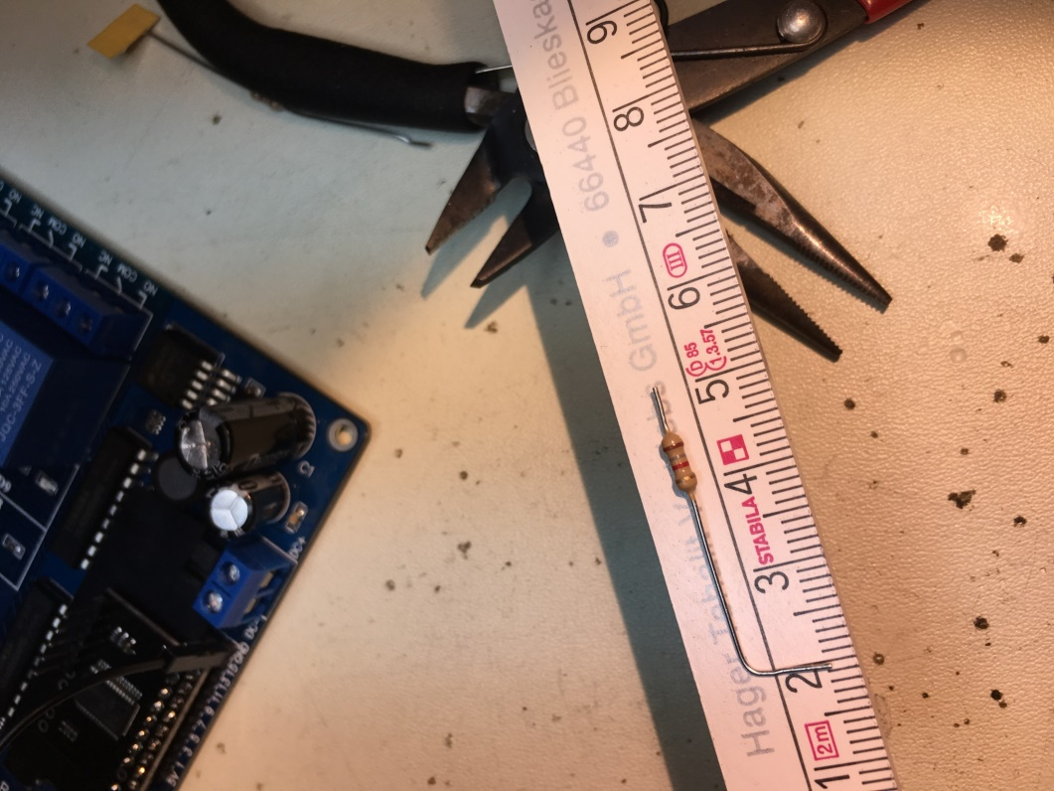
Preparing your ESP-12F… 1
Solder Female Header & prepare your 1k8/2k2 resistors:

Slide 32
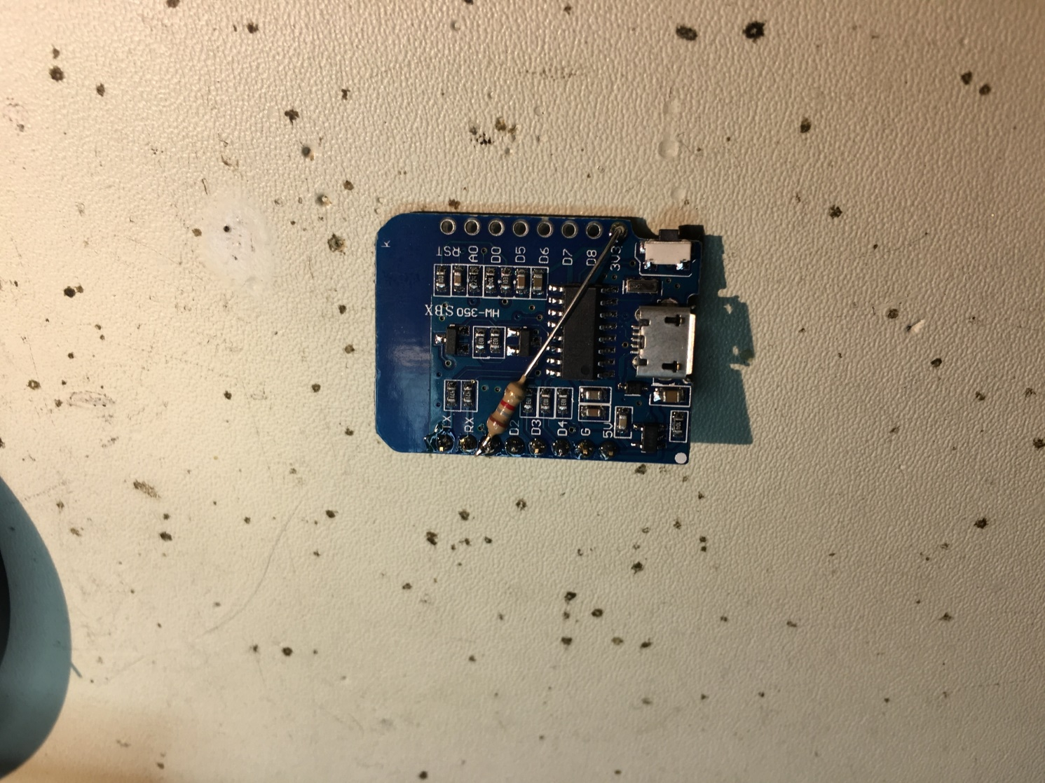
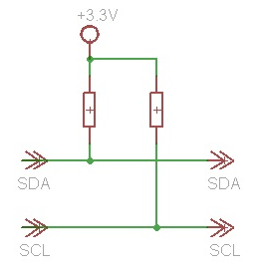
Preparing your ESP-12F… 2
Solder your first 1k8/2k2 resistor. Pin D1 ➔ 3V3!
Be careful :P…

Slide 33
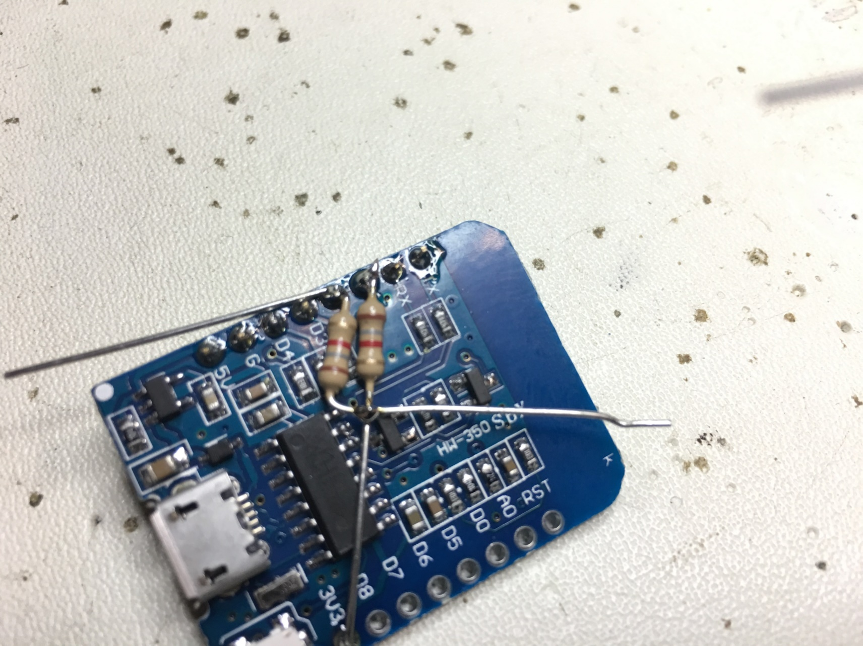
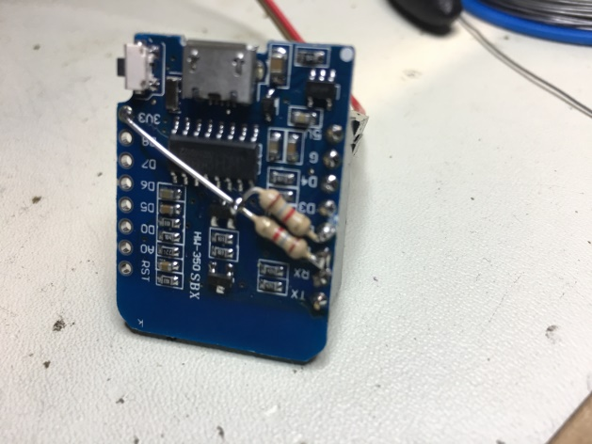
Preparing your ESP-12F… 3
Bent your second resistor 1k8/2k2 into an „S“ and solder it.
D2 ➔ 3V3
Cut.
Be careful :P…

Slide 34
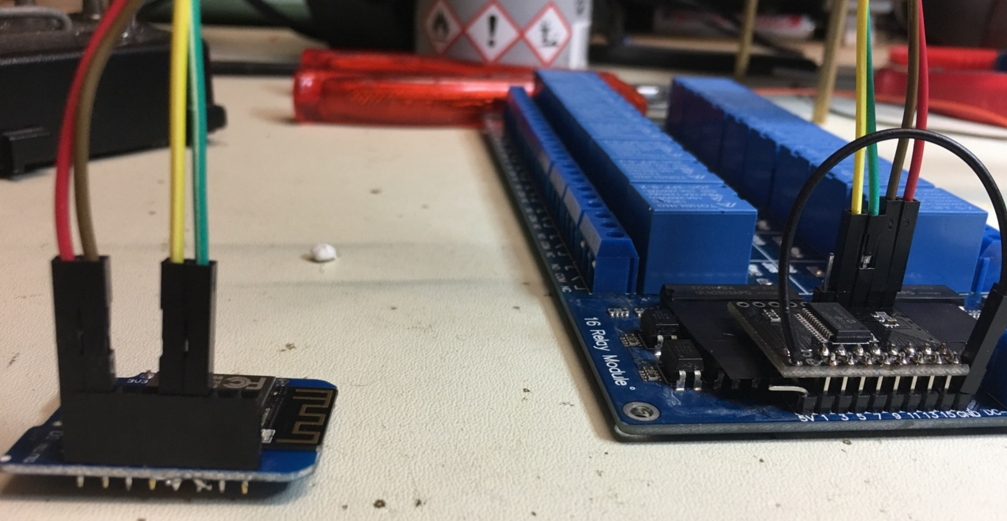
Put it all together…
Wemos from left to right (example): 5V|GND|empty|empty|yellow|green
MCP from the left: Yellow|Green|GND|5V
SCHWARZ to GND (Relayboard)
Your wire colors may be different!

Slide 35
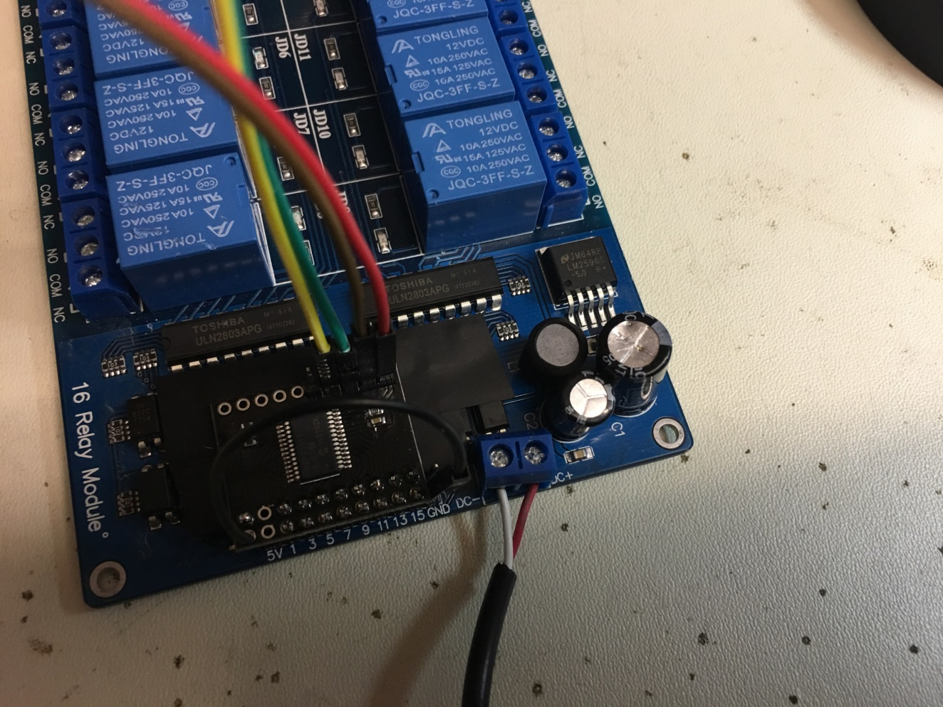
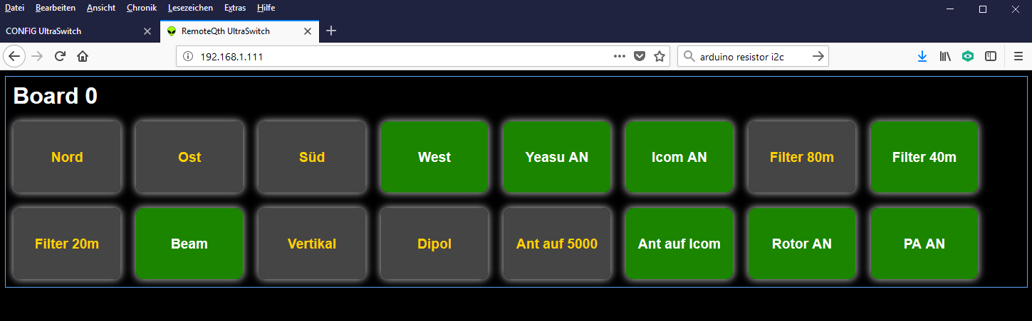
Finally…
Connect your power supply 12V
Power on
Start your browser
Be happy! ☺

Slide 36
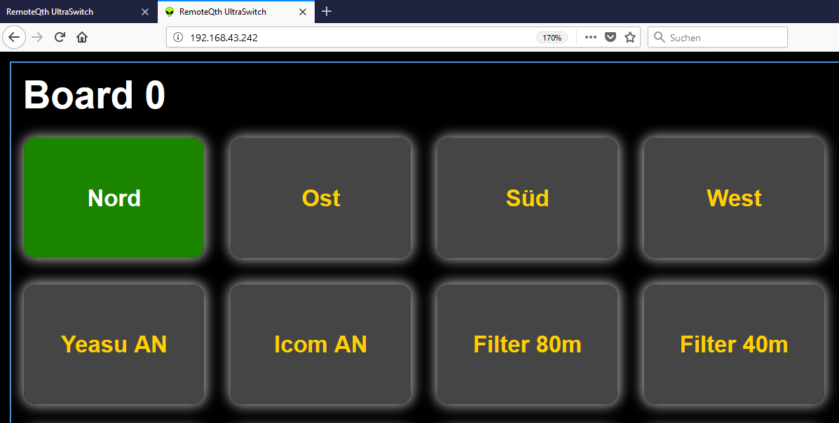
Back to the beginning... Use Case 1
Call your ultraswitch by its ip
The Ultraswitch returns his index.html
Labels, groups, … are loaded from h.mmmedia-online.de
No customizing necessary if this fulfills your needs..
This should be step 1 befor customizing!

Slide 37
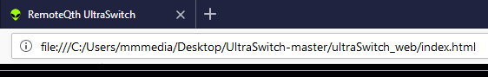
Back to the beginning... UseCase 2... 1
The Ultraswitch is called using your local stored (eg. desktop) index.html
E.g file:///C:/Users/mmmedia/Desktop/UltraSwitch-master/ultraSwitch_web/index.html
All files can be local: Customize!

Slide 38
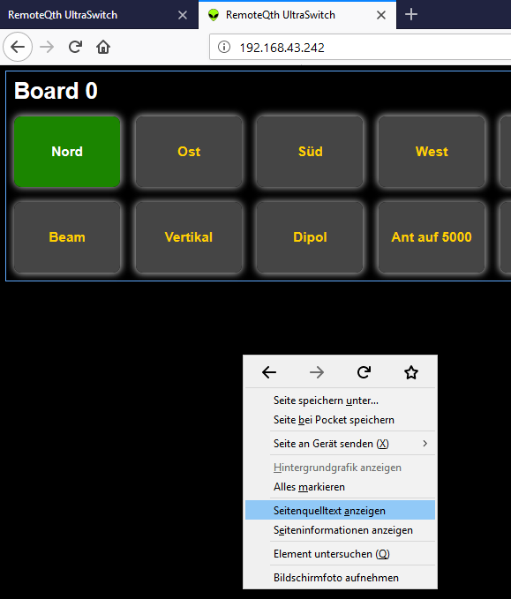
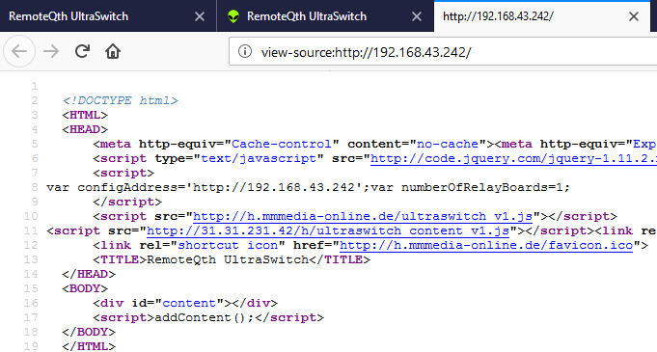
Back to the beginning... Creating your own index.html... 1
Call Ultraswitch by IP e.g. 192.168.43.242
Right-Click somewhere to the black backround of the webpage and say „show source code“
Copy the complete text into your clipboard(ctrl+a, ctrl+c)

Slide 39
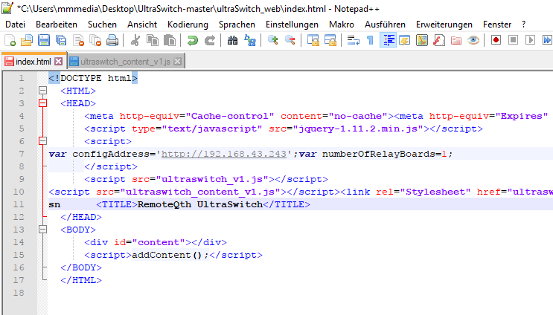
Back to the beginning... Creating your own index.html... 2
Open th index.hml from your ultraswitch_web folder with an Editor .
Remove all the code
Past the text from your clipboard (ctrl+v)
Open the new index.html. All should be visible like before – if not look into CORS (see slide about CORS)

Slide 40
UseCase 2... All local!
If all needed files are all in the same local directory like your index.html, than you can change the file paths like this: e.g. change src=„http://h.mmmedia-online.de/ultraswitch_v1.js“ to this src=„ultraswitch_v1.js“
If all http://<url>/<filename> changed into <filename>, all is working without the internet
Problem: jquery must be local, too! To be completly independent from the internet.
Ask someone you who knows how to do web pages for help.

Slide 41
Customizing => Labels, Groups, RelaysPerBoard
Customizing your ultraswitch_content_v1.js:
Labels => textboard0 = Labels for the 1. Board etc… var textboard0 = ["Nord","Ost","Süd","West","Yeasu AN","Icom AN","Filter 80m","Filter 40m","Filter 20m","Beam","Vertikal","Dipol","Ant auf 5000","Ant auf Icom","Rotor AN","PA AN"]; ➔ Change it, but keep it short!!
Groups => board0Group = Grouping pins definition for your 1. Board… var board0Group = [[0,1,2,3],[6,7,8],[9,10,11],[12,13]]; What does it mean: On Board 1 with the id 0 are 4 groups defined. First group: button 0,1,2,3 is connected together in a way “there can be only one”-
numberOfRelaysPerBoard = How many Relays per Board (1., 2., 3.,…) var numberOfRelaysPerBoard = [14,16,16,16,16,16,16,16,16,16,16,16,16,16,16,16]; What does it mean: Your first board controls 14 Relays, 2nd 16, ….

Slide 42
UseCase 3... Using your own Webspace /webserver
Your own Webserver (e.g. RaspiPI):
Use Config.html to point the content IP-Adresse to your OWN WEBSERVER.
The URL to ultraswitch_content_v1.js and ultraswitch_v1.css is generated by naming convention: http://<own_ip>/h/<filename>!
HowTo:
Create a subdirectory named „h“ in your webserver/webspace root.
Copy your own Ultraswitch_content_v1.js und ultraswitch_v1.css into this folder.
Call Ultraswitch just with its IP! Its not needed to call the Ultraswitch by your local index.html (but you sure can)
If you are using a Raspberry PI , hosting all files there makes sense (incl. your own index.html)

Slide 43
Trouble with the Ethernet-Lib…
Due to the age of the Ethernet-Lib implementation, the lib has some problems with dealing with modern browsers – especially with the number of connections opened.
The Ethernet lib can handle 4-10 connections, depending on the ethernet chip. But a modern browser opens dozens over dozens.
Too many open connections create a problem with the number of open sockets. Race conditions ocour – the System is not answering after a while.
Workaround: MicroFox (see folder „Software“) – a portable customizes version of the firefox. The number of max-connections is set to 2. This is very good calling your ultraswitch, but not very cool while surfing. So just use this browser for communication with the ultraswitch only if you are running into connection problems. (Your mobile firefox can be customizes too – see about:config and search for max-connections)

Slide 44
Architecture of the source code
Main-Sketch is used to control the ESP12F hardware, JSON, WebServer: UltraSwitch.ino
Liraries: Adafruit-MCP23017 ➔ I2C control MCP23017 ArduinoJson ➔ JSON for the Webserver-Response WiFiManager ➔ Easy setup your wifi webserver
Ultraswitch_content_v1.js ➔ Configure Labels, groups, etc. (Naming) Ultraswitch_v1.js ➔ Switching logic and controlling UI-Dom-Elements Ultraswitch_v1.css ➔ UI Look&Feel, buttonsize, colours, etc. (Buttons)
Setup_esp.html ➔ Preconfigure your ESP12F Access-Points Config.html ➔ Configure IP- and Serverpreferences index.html ➔ Local ESP12F application

Slide 45
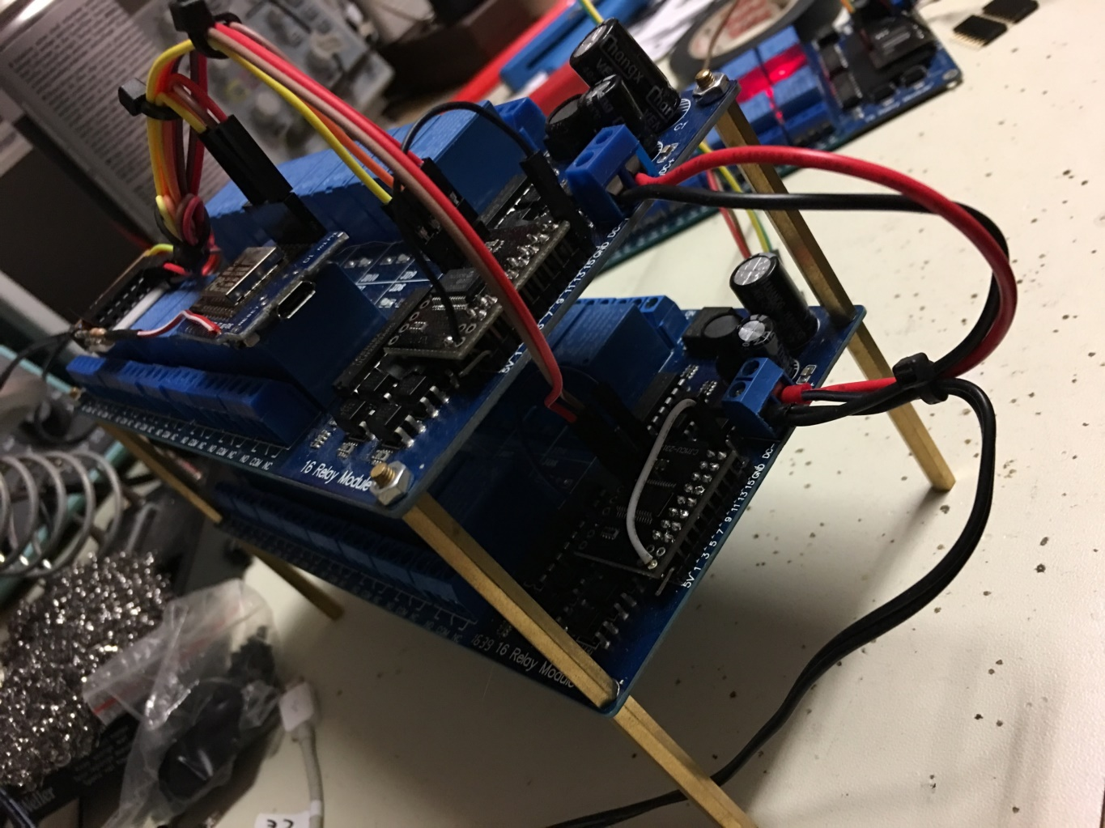
Extention with more 16CH modules…
Build more Relayboard+MCP units
Set their unique I2C-Adress! (see next slide)
Just connect the 2 I2C-cables for SCA and SCL (Parallel-Bus)
Attach 12V
Configure Config.html ➔ Set the amount of boards
done! (Without a firmware upload)

Slide 46
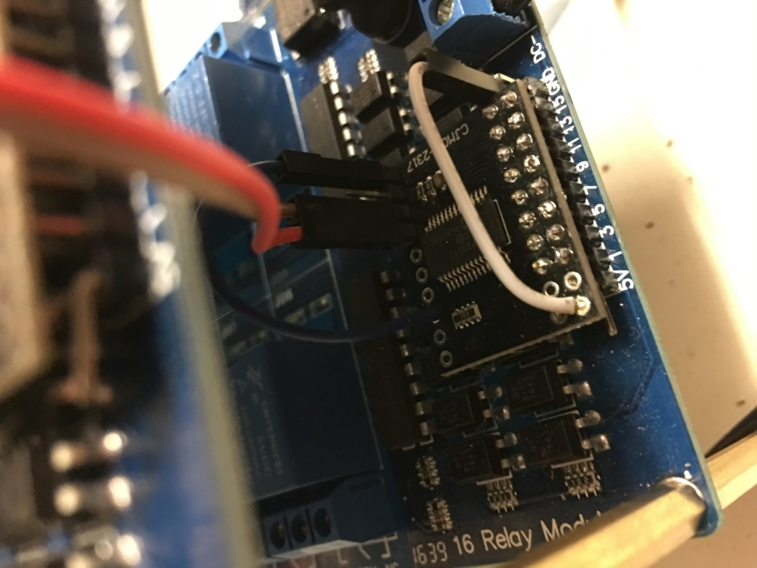
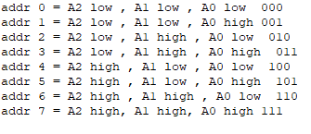
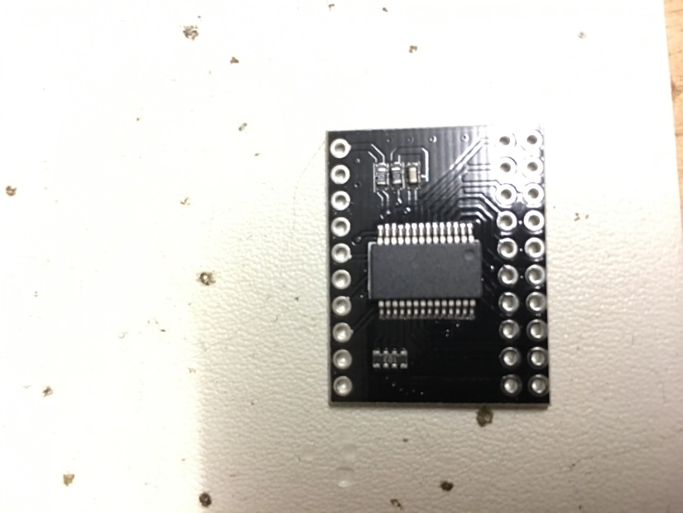
More moduls… Set the I2C adresses => Up to 8 devices!
With setting the desired Pin to HIGH (5V) you can control how many boards are connected: 0 => 1st board, 1 => 2nd board, 2=> 3rd board, …!!!
Hint: Not connected => LOW
A0
A1
A2
5V
GND
SCL
SCA

Slide 47
A lot of space to create your own projects…
A Ultraswitch-Cluster
Using the ADC-IN port for measurements (Temp, etc.)
For antenna switching (Hint: Shielding, Housing…)
Time controlled Pins (see mega-webswitch)
Integration into N1MM (ask M. Hammelmann, DK5AX)
Remote-Switch for Remote Stations (Using VPN is highly recommended)
Integration with a Raspberry PI as your server (UDP, Broadcast)
…

Slide 48
THE END - If you are running into a problem, contact us. We will never leave you alone! –
The user Hard- and Software, Architecture and Firmware is protected by: Attribution-NonCommercial-ShareAlike 4.0 International (CC BY-NC-SA 4.0) - Email: dm5xx@gmx.de -

